Slide 1
HUMAN DIGESTIVE SYSTEM
B.A 1st(Home Science)

Slide 2
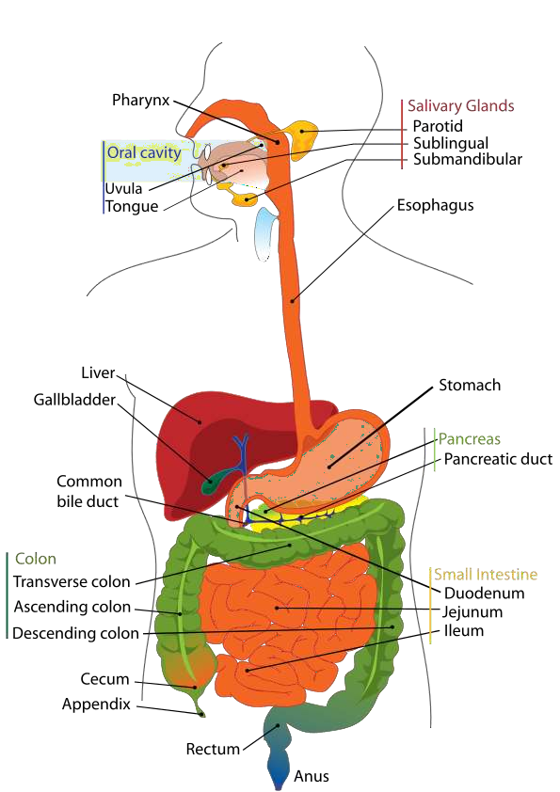
Structure of the Human Digestive System

Slide 3
Digestion
The chemical breakdown of complex biological molecules into their component parts.
  Lipids to fatty acids
  Proteins to individual amino acids
  Carbohydrates into simple sugars

Slide 4
Mouth or Buccal Cavity
The mouth has teeth and tongue. Salivary glands are also present in the mouth. The tongue has gustatory receptors which perceive the sense of taste. Tongue helps in turning over the food, so that saliva can be properly mixed in it.
Teeth help in breaking down the food into smaller particles so that swallowing of food becomes easier. There are four types of teeth in human beings. The incisor teeth are used for cutting the food. The canine teeth are used for tearing the food and for cracking hard substances. The premolars are used for coarse grinding of food. The molars are used for fine grinding of food.
Salivary glands secrete saliva. Saliva makes the food slippery which makes it easy to swallow the food. Saliva also contains the enzyme salivary amylase or ptyalin. Salivary amylase digests starch and converts it into sucrose.

Slide 5
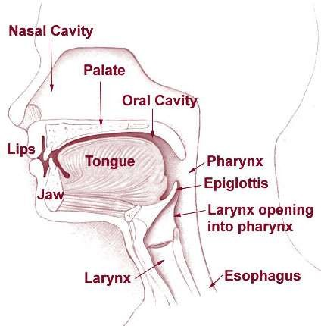
Mouth or Buccal Cavity

Slide 6
Oesophagus
A straight muscular tube that is about 10 inches
(25 cm) long which connects the mouth with the stomach
Food takes about 4 to 8 seconds as it passes through to the stomach.
Its walls contain smooth muscles that contracts in wavy motion (Peristalsis).
Peristalsis propels food and liquid slowly down the esophagus into the stomach.
Cardiac Sphincter (ring-like valve) relaxes to allow food into the stomach

Slide 7
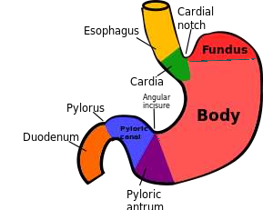
Stomach
Stomach is a bag-like organ. Highly muscular walls of the stomach help in churning the food. The walls of stomach secrete hydrochloric acid. Hydrochloric acid kills the germs which may be present in food. Moreover, it makes the medium inside stomach as acidic. The acidic medium is necessary for gastric enzymes to work. The enzyme pepsin; secreted in stomach; does partial digestion of protein. The mucus; secreted by the walls of the stomach saves the inner lining of stomach from getting damaged from hydrochloric acid.

Slide 8
Small Intestine
Takes about 4 – 8 hrs to complete its journey.
Mucosa (inner wall) – secretes several enzymes that acts on the food.
Where the pancreatic enzymes are emptied into.
Digested nutrients are absorbed through intestinal walls.
Absorbed materials cross the mucosa into the blood then other parts of the body for storage or further chemical change.

Slide 9
Small Intestine
Has folded inner walls covered with fingerlike projections (villi; sing. – villus)
Each villus has tinier projections called microvilli
that absorbs digested food.
Villi and microvilli increases the surface area of the small intestine for greater absorption.
Peristalsis moves the undigested food to the large intestine.

Slide 10
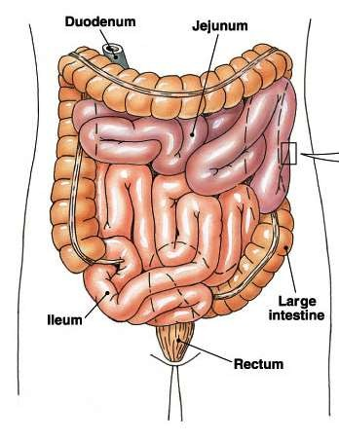
Small Intestine

Slide 11
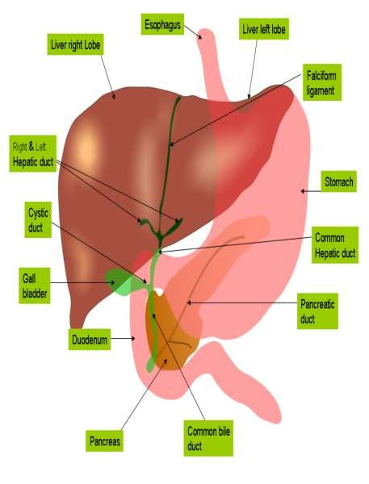
Liver
Liver is the largest organ
in the human body.
Liver manufactures bile;
which gets stored in gall
bladder. From the gall
bladder, bile is released
as and when required.

Slide 12
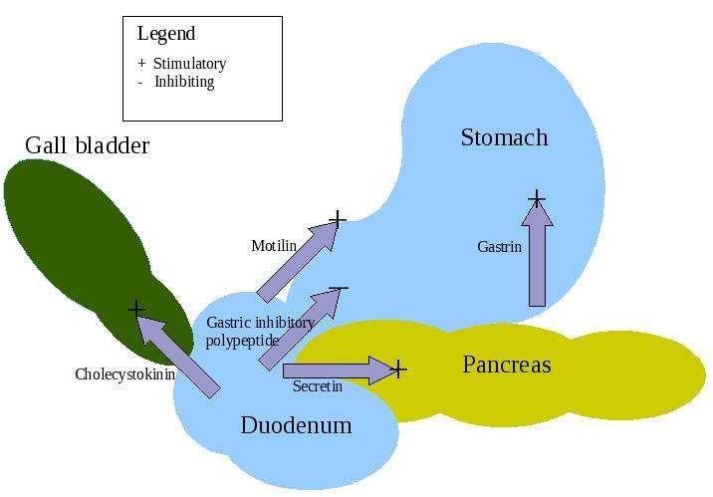
Pancreas
Pancreas is situated below the stomach. It secretes pancreatic juice which contains many digestive enzymes.

Slide 13
Large Intestine
Large intestine is smaller than small intestine. Undigested food goes into the large intestine. Some water and salt are absorbed by the walls of the large intestine. After that, the undigested food goes to the rectum; from where it is expelled out through the anus.

Slide 14
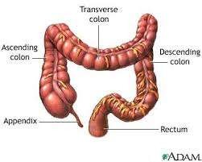
Large Intestine

Slide 15
Removal of Wastes
Egestion
  removal of digestive waste.
Excretion
  removal of metabolic waste.

